Slide 1

INFRA CENTRALIZATION (IC) System
CODE G
Know it Now
Ram Shakti Singh Rachit Shukla Raman Kumar Poorna Ravimakula

Slide 2



Problem Statement
Awareness
Lack of awareness on hospitals infrastructure
No where to look for answers
Accessibility
No Guaranteed Supported System
Inter hospital support system for infra and staff
Availability
Availability of doctors & other staff for any other emergencies
Availability of medicine or any other requirements or medications

Slide 3
Impacted AreaS
Covid-19 affected Zone
Emergency cases such as accidents, pregnancy deliveries, heart attack etc..,
Small & medium level hospitals or clinics staff & reputation
Infrastructure Business Areas

Slide 4
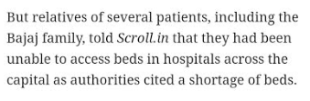
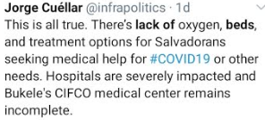
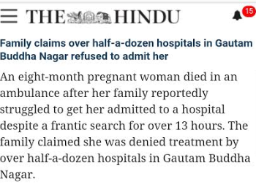
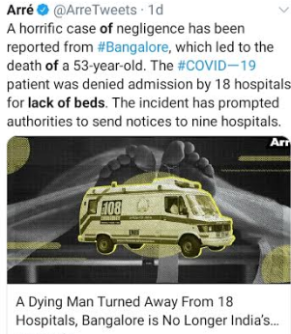
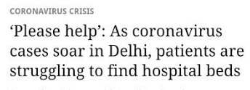
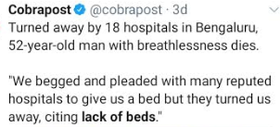

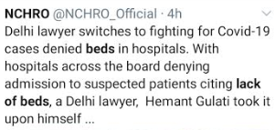
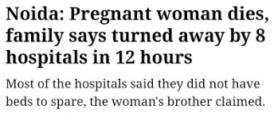
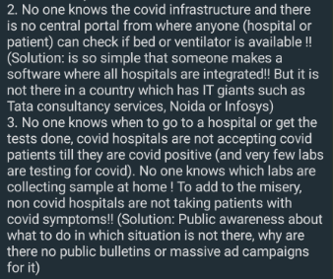
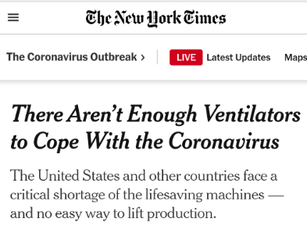
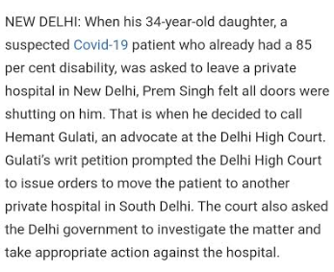
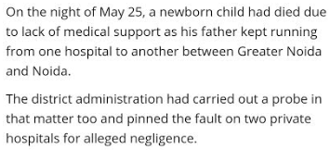

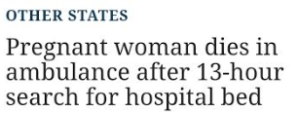
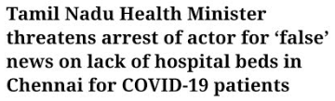

Slide 5
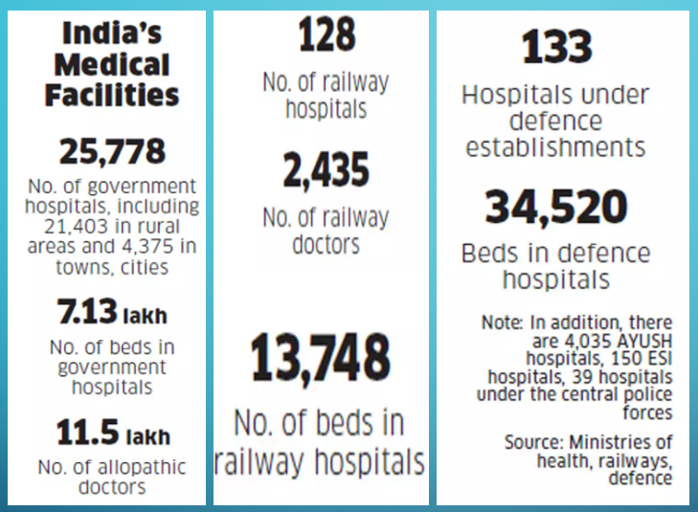
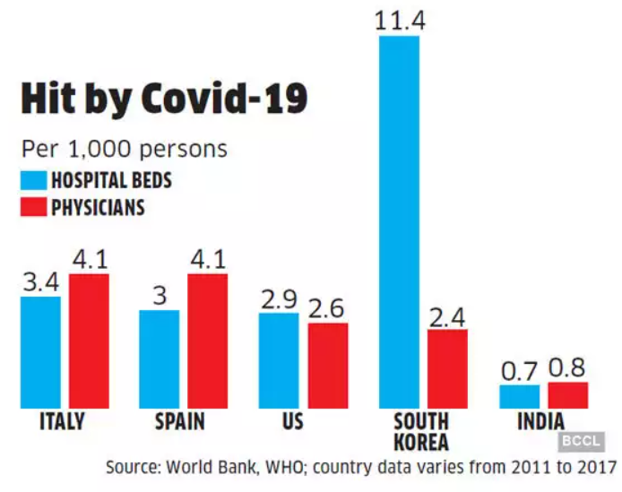

Slide 6
SOLUTION
Awareness
Centralized system to know about disease & required infrastructure
Booking facility in advance for hospitals beds, infra or any tests
Accessibility
Guaranteed Supported System with pre or post paid mechanisms for both consultation & infrastructure
Inter hospital support system to search & book infra or staff from one hospital to another using rental or buying mechanisms
Availability
Transparency on visibility of doctors & other staff for any other emergencies
Stock availability and immediate booking facility in any situation

Slide 7





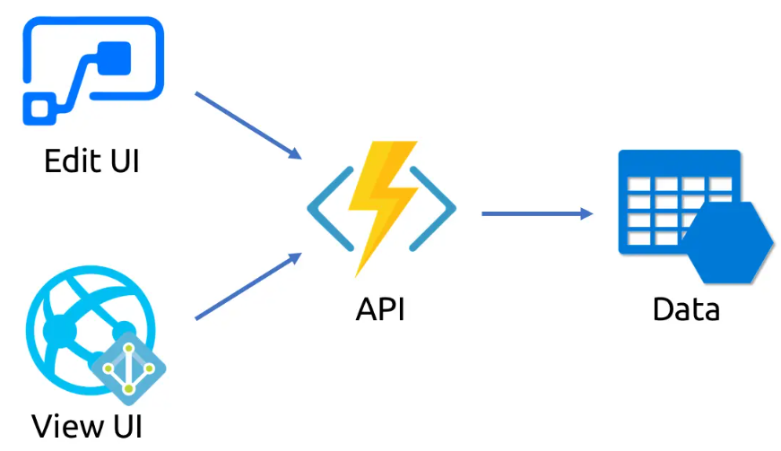




High Level Architecture
IBM WATSON
MAP SERVICES
Report Generation
US
E
R
S
Power Automate
Trend Analysis
Health Care Units
IC PORTAL
Notifications

Slide 8
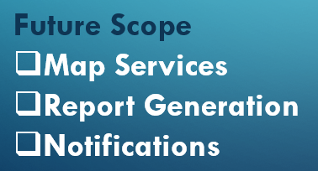
Technology Terms
Power Apps
Power Automate
IBM Cloudant
IBM Watson
IBM Discovery

Slide 9
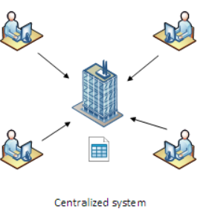
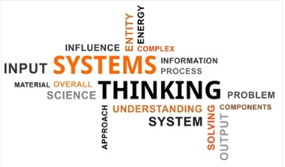

What It does to CUSTOMERS
A single centralized system for every need
Simple way to connect to the world of infrastructure
Awareness on any kind of disease and required equipment – Educates people in simple terms
Easy mechanisms to know the list of Authenticated hospitals & information
Notify mechanisms to be up to date
Provides secure & accurate results
Identify trend and foresee the risks & future needs
Understands user needs and give accurate suggestions
Guide people to right way on emergency situations
Gives necessary actions before reaching to health care center
Consistent support between health cares on any kind of situation
Provides confidence to medical units incase of lack of medicines
Staff rotation would be made easier
Reduces dependencies on single or few hospitals

Slide 10
Cost vs Benefits
Reducing multiple payments during searching process and other criteria
Payment analysis provides time to prepare and analyze the total bill based on needs
Loan or financial systems integration can help people to get instant loans
Organization benefits or discounts to be applicable
Benefits & discounts on medicines
Hospital staff cost to be minimized as support gets on rotations & as per demand
Sharing Infrastructure increases reusability between health care centers
Medium & Small scale business units are benefited due to increase of demand
Rental infrastructure reduces the great amount of cost
Maintenance cost will be eventually reduced in hospitals as everything goes in a centralized way
Peak time demands will be shared with small health care centers so all every registered health care center gets benefited.

Slide 11


Looking forward for more collaboration…
IC SYSTEM
RAM SHAKTI SINGH
RACHIT SHUKLA
RAMAN KUMAR
RAVIMAKULA POORNA

